Slide 1



Automated Sericulture SmartGrid : Revolutionizing Silk Farming with Technology
DEPARTMENT OF ELECTRONICS AND COMMUNICATION ENGINEERING
PRESENTED BY,
MEIPRASAANTH V - 21ECR116
JEGAN M – 21ECR089
JEGAN P – 21ECR090
GUIDED BY,
Mrs.V.MEKALA M.E.,
ASSISTANT PROFESSOR(SR.G),
DEPARTMENT OF ECE,
KEC.

Slide 2
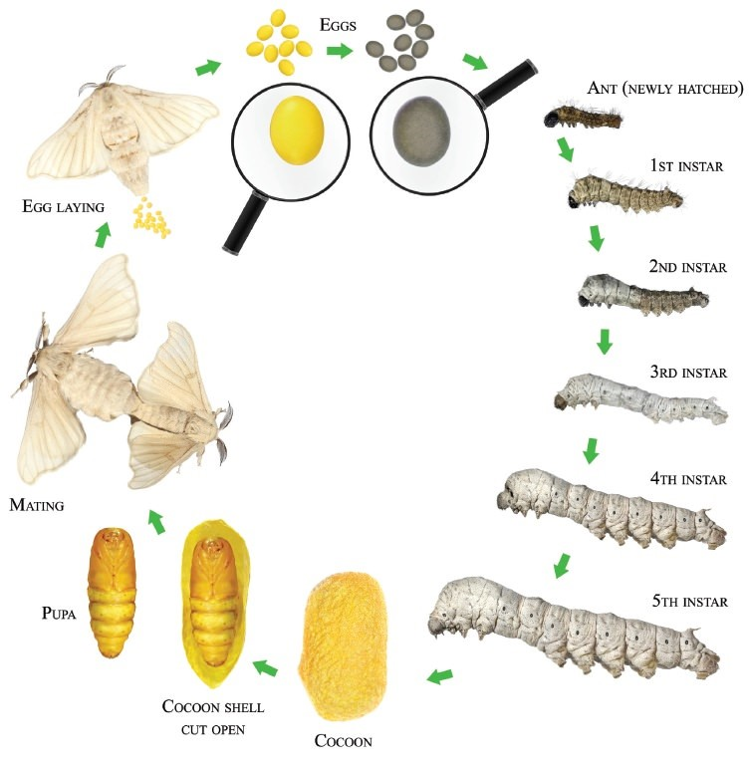
INTRODUCTION
Sericulture, the art of cultivating silkworms for silk production, is a meticulous and labour-intensive process with roots tracing back thousands of years. It begins with the cultivation of mulberry trees, whose leaves are the primary food source for silkworms. The process starts when silkworm eggs hatch into larvae, which are then fed a steady diet of mulberry leaves. As the larvae grow, they undergo several moulting stages (5 Instars), shedding their skins four times before they start spinning their cocoons.

Slide 3
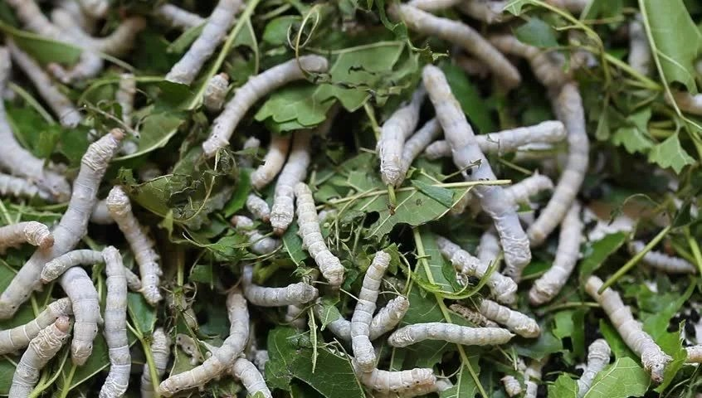
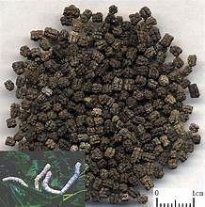
PROBLEM STATEMENT
Sericulture, the cultivation of silkworms for silk production, faces several challenges that hinder its efficiency and productivity. Traditional methods rely heavily on manual labor and constant monitoring, leading to inconsistencies in maintaining optimal conditions for silkworm growth. Key issues include:
Inconsistent Environmental Control: Maintaining the ideal temperature (25-29°C) and humidity levels (70-80%) manually is labor-intensive and prone to human error, affecting the health and productivity of silkworms.
Feeding and Waste Management: Manual feeding of mulberry leaves and cleaning of waste is time-consuming and inefficient, leading to suboptimal growth conditions and increased labor costs.

Slide 4
OBJECTIVE
The project aims to modernize sericulture through automation. It focuses on three main areas are automating environmental control using temperature and humidity sensors with heaters and coolers and optimizing feeding with stepper motor and waste management with air blower.

Slide 5
LITERATURE REVIEW
S.NO | TITLE | AUTHOR NAME | JOURNAL NAME & YEAR O | REMARKS
1. | Tsukamoto Fuzzy Inference System on Internet of Things-Based for Room Temperature and Humidity Control. | Sunardi1, anton yudhana1, and furizal | IEEE Access ( Volume: 11),2023. | The system uses fuzzy rules to read temperature and humidity sensors. It then adjusts heating, cooling, and humidifying devices based on this data.
2. | A Review of Silk Farming Automation Using Artificial Intelligence, Machine Learning, and Cloud-Based Solutions. | Cox S., Ullah A., Ahmad J. | Springer, 2019 | This review looks at how AI and machine learning can be used in silk farming to improve different stages of the sericulture process.
3. | Classification of Dead Cocoons Using Convolutional Neural Networks and Machine Learning Methods. | Dahyeong lee 1, giyoung kim1, suk-ju hong1, seong-wan kim2 and ghiseok kim | IEEE Access ( Volume: 9),2022. | The paper looks at using deep learning to find dead cocoons in sericulture. It tests several algorithms, including k-nearest neighbor, support vector machine, and CNN models like VGG16, ResNet50, and EfficientNetB0..

Slide 6
LITERATURE REVIEW
S.NO | TITLE | AUTHOR NAME | JOURNAL NAME & YEAR O | REMARKS
4. | A Study on the Sericulture Farm Automation System Using the Internet of Things (IoT). | Doloi A, Barkataki N, Saikia M, Saikia D. | Springer,2021 | This paper discusses the development of a wireless sensor network-based system for monitoring various ambient conditions crucial for the rearing process of ERI silkworms. It highlights the application of IoT in sericulture to improve efficiency and productivity.
5. | Modeling Simulation and Temperature Control on Thermal Characteristics of Airborne Liquid Cooling System . | Zhangzhi dong , xiaogang li, zhe li , and yanyan hou | IEEE Access ( Volume: 8),2020. | It involves studying heat behavior, making models to predict temperature changes, and creating control systems for effective temperature management. This is important for applications that need accurate temperature control to ensure performance and reliability.
6. | Flexible and Slim Device Switching Air Blowing and Suction by a Single Airflow Control. | Seita Nojiri , Toshihiro Nishimura ,Kenjiro Tadakuma and Tetsuyou Watanabe. | IEEE Access ( Volume: 14),2023. | This system uses a single airflow mechanism for both blowing air and suction. It is compact, flexible, and thin, making it ideal for use in tight spaces and adaptable applications.

Slide 7
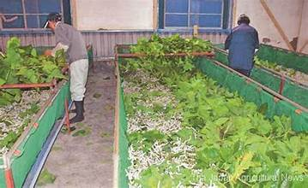
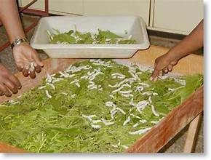
EXISTING METHOD
The traditional sericulture process needs much labor and careful monitoring and precise care to ensure high-quality silk production. Here are the key existing methods involved in the sericulture process:
1. Environmental Control:
Challenges: This manual process is labor-heavy and can result in mistakes, leading to poor conditions for silkworms and silk quality.
2. Feeding Silkworms:
Challenges: Silkworms need regular, timely feeding for healthy growth. Manual feeding need heavy labor and can cause uneven feeding times.
3. Waste Management:
Challenges: Poor waste management can cause poor hygiene and raise the risk of disease in silkworms.

Slide 8
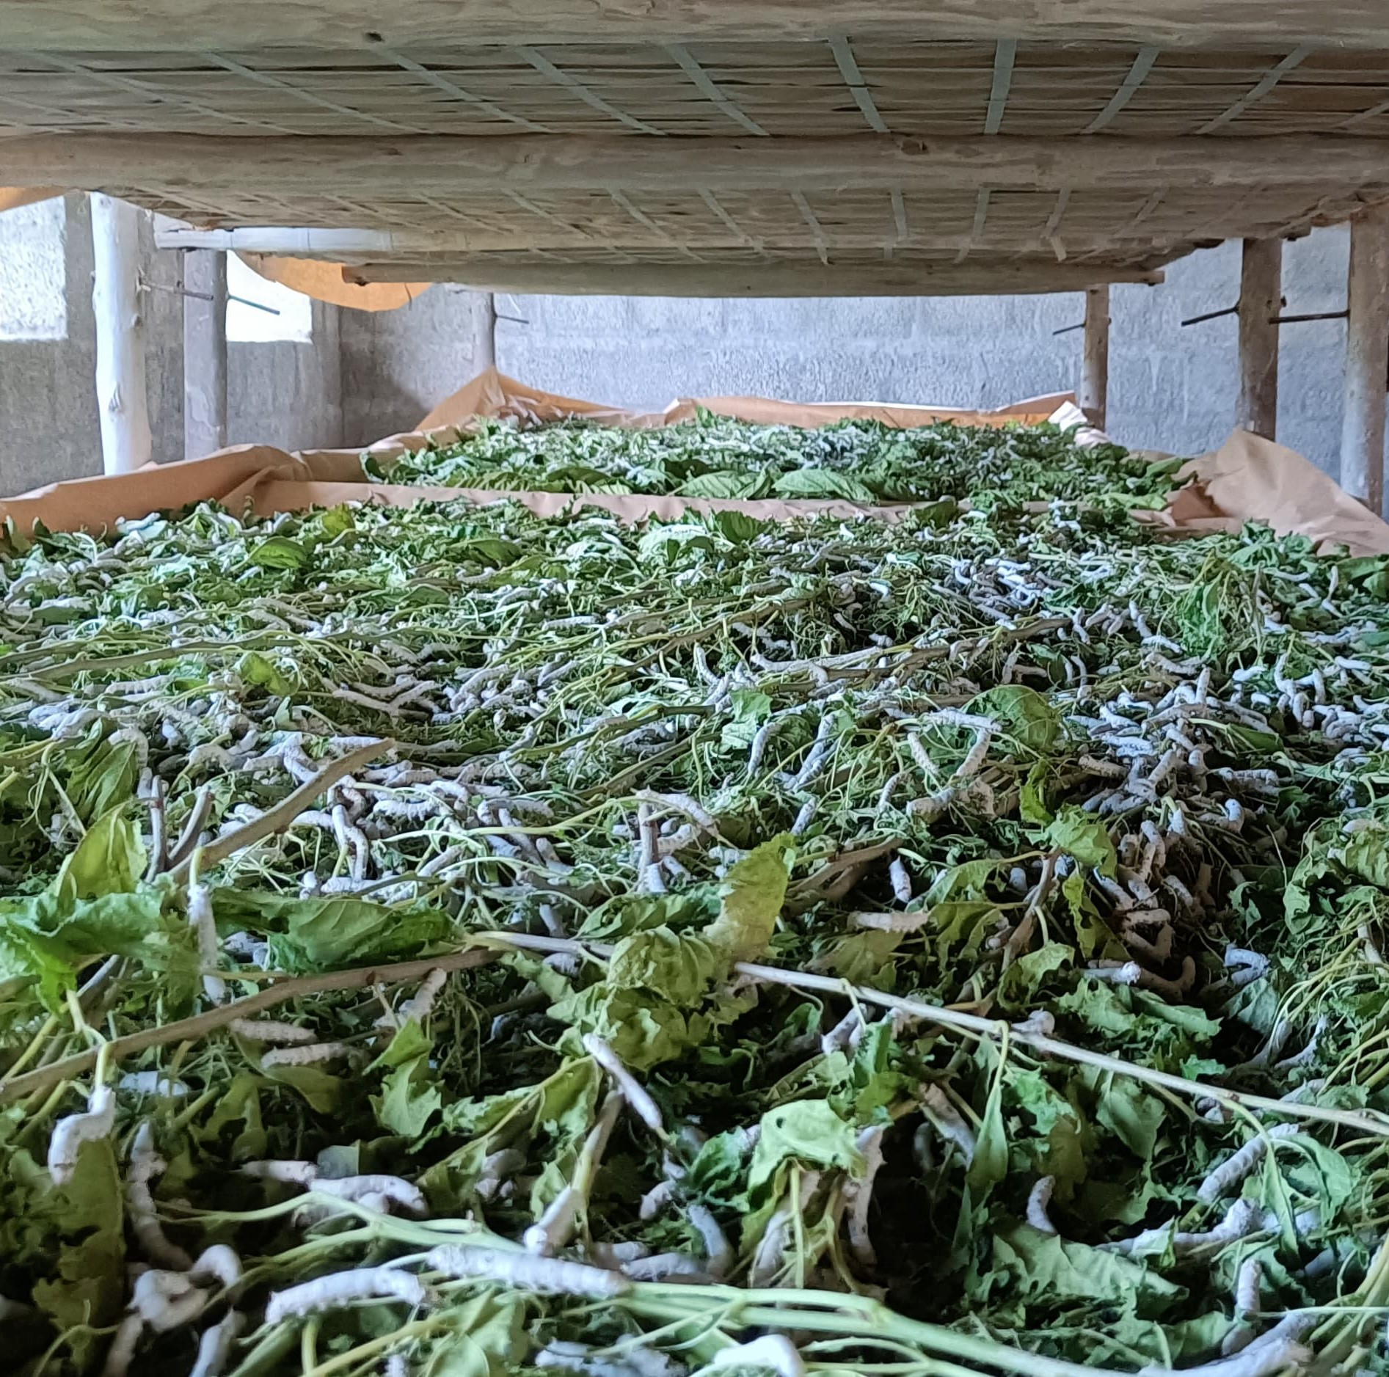
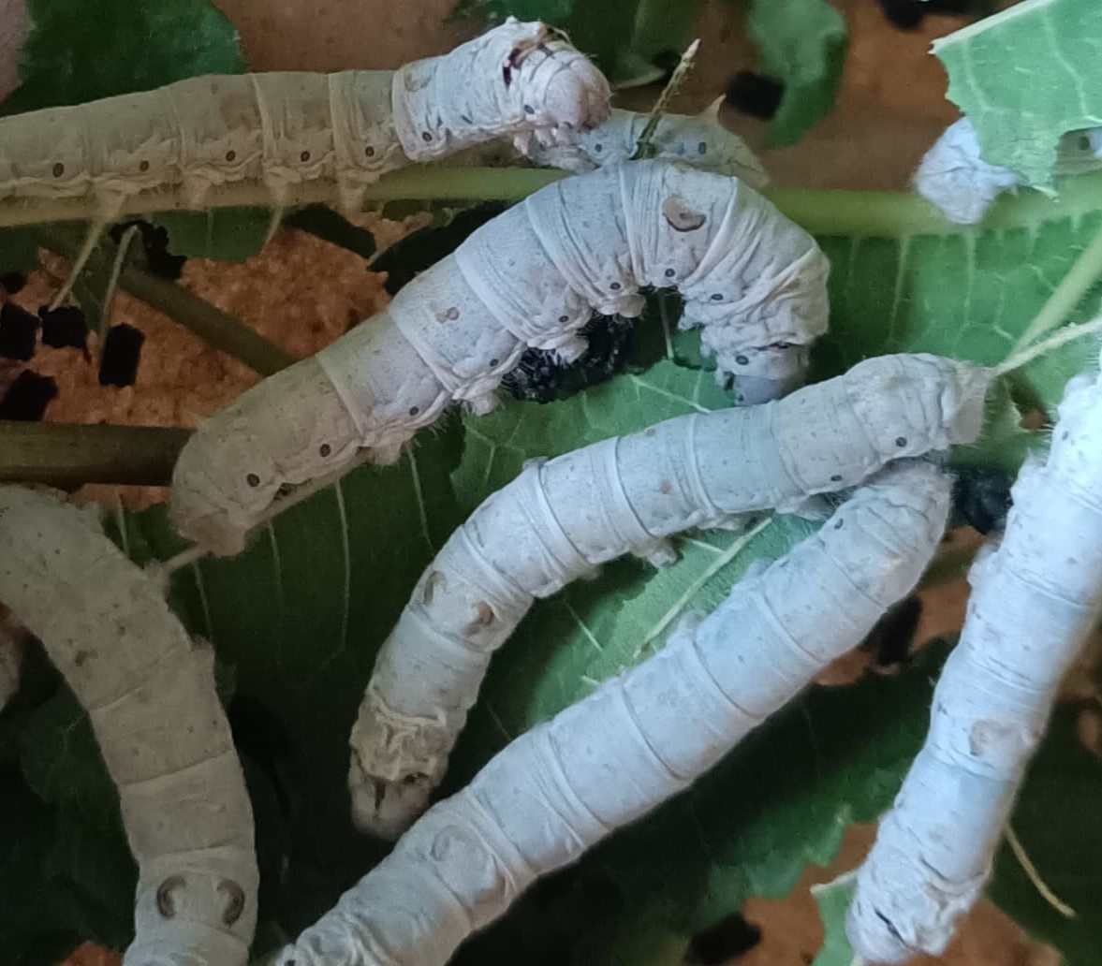
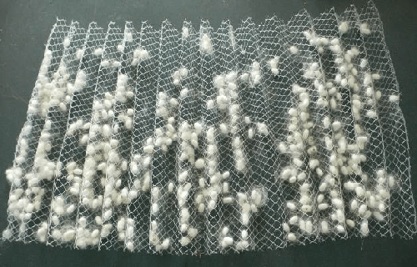
FARM VISIT
Location : Dhalavoipattinam, Dharapuram District, Tamilnadu – 638672.

Slide 9
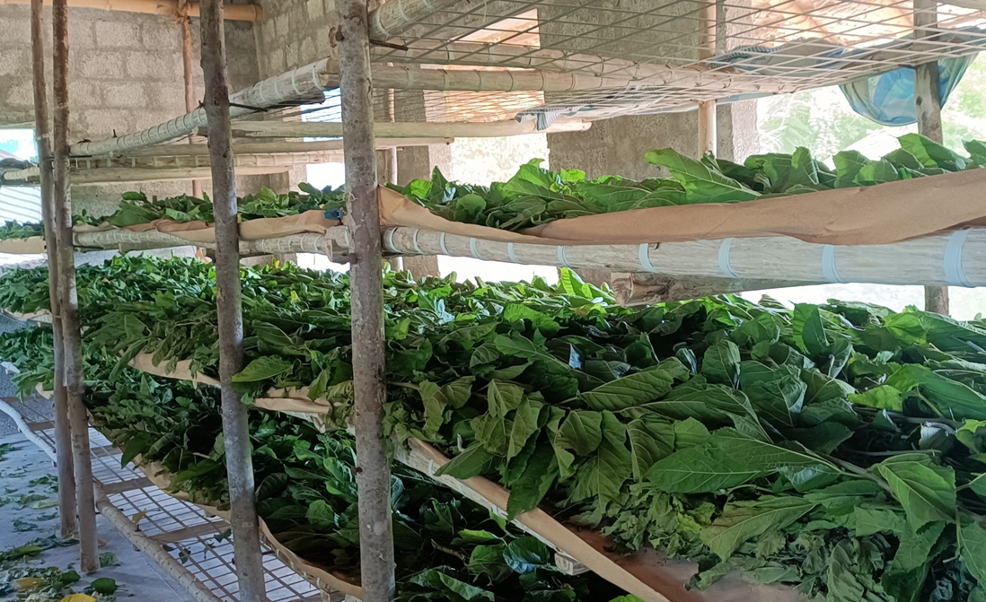

Slide 10
PROPOSED METHOD
Automated Environmental Control:
Sensors and Actuators: Temperature and humidity sensors continuously monitor the environment. Based on sensor readings, automated heaters and coolers are activated to maintain optimal conditions (25-29°C and 70-85% humidity).
Lime Powder Spraying: An automated system sprays lime powder daily to prevent diseases and maintain silkworm health.
Automated Feeding System:
Hopper and Stepper Motor: A hopper placed on a stepper motor moves along one axis using a rack and pinion mechanism to distribute mulberry leaves evenly to the silkworms.
Automated Waste Management:
Air Blowing System: A tray placed under the worm trays collects waste, which is then removed using a strong air-blowing system.
Instars | Temperature and Humidity
1st and 2nd instars | 26–28°C (78–82°F) with 85% humidity
3rd instar | 24–26°C (75–81°F) with 80% humidity
4th instar | 24–25°C (75–77°F) with 75% humidity
5th instar | 24°C (75°F) with 70% humidity

Slide 11
BLOCK DIAGRAM
+
LCD DISPLAY
OUTPUT MODULE
STM32
Nucleo
F411RE
INPUT MODULE
HEATER / COOLER CONTROL MECHANISM
AUTOMATED FEEDING MECHANISM
HUMIDITY SENSOR
DHT11
RELAYS
LIME POWDER SPRAYING MECHANISM
AIR BLOWER
POWER SUPPLY

Slide 12
COMPONENTS AND ITS SPECIFICATION
SI.NO | COMPONENTS | SPECIFICATIONS
1) | STM32 Nucleo F411RE | The STM32 Nucleo F411RE is a compact development board featuring an STM32F411RE microcontroller with a Cortex-M4 core, 512 KB Flash, and 128 KB SRAM. It offers a rich set of peripherals, on-board ST-LINK/V2 debugger, and Arduino compatibility, making it ideal for rapid prototyping and embedded applications.
2) | Humidity Sensor (DHT11) | It can measure humidity from 20-90% with a ±5% accuracy and temperature from 0-50°C with a ±2°C accuracy.
3) | Stepper Motor | A stepper motor is a precise electromechanical device that converts electrical pulses into discrete mechanical movements. It typically operate at input voltages ranging from 5V to 48V, depending on the motor type and application. The current rating varies between 0.1A to 5A per phase, with higher torque motors requiring more current.
4) | Relays | It is an electrically operated switch that uses an electromagnet to mechanically control a circuit. It allows low-power signals to control high-power circuits, making it useful for isolating and controlling devices that operate at different voltages.

Slide 13
SI.NO | COMPONENTS | SPECIFICATIONS
5) | Solenoid Valve | It operates using an electromagnetic solenoid to actuate a valve mechanism, which opens or closes to regulate flow. When electrical current passes through the solenoid coil, it creates a magnetic field that moves a plunger or armature, thus operating the valve.
6) | LCD Display | It is a type of alphanumeric liquid crystal display with 16 columns and 2 rows, allowing it to show up to 32 characters at a time. It uses a HD44780 controller or compatible for interfacing, which simplifies communication with microcontrollers.
7) | I2C Module | It is a type of alphanumeric liquid crystal display with 16 columns and 2 rows, allowing it to show up to 32 characters at a time. It uses a HD44780 controller or compatible for interfacing, which simplifies communication with microcontrollers.
8) | Power Supply | A 5V power supply provides a stable 5-volt direct current (DC) output, commonly used to power electronic devices and circuits.

Slide 14
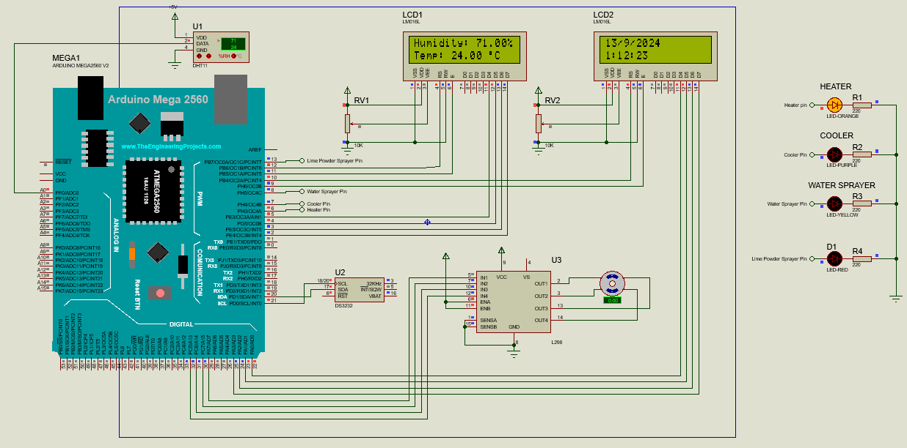
SIMULATION CIRCUIT
Video Link:
https://drive.google.com/file/d/1ZrrsGEdAYjNnPzSfMOFWEm3ulf6G1N4N/view?usp=drive_link
https://drive.google.com/file/d/1I-0BFHuIoVCgO4fwD2zXDawk9wwJs8dR/view?usp=drive_link

Slide 15
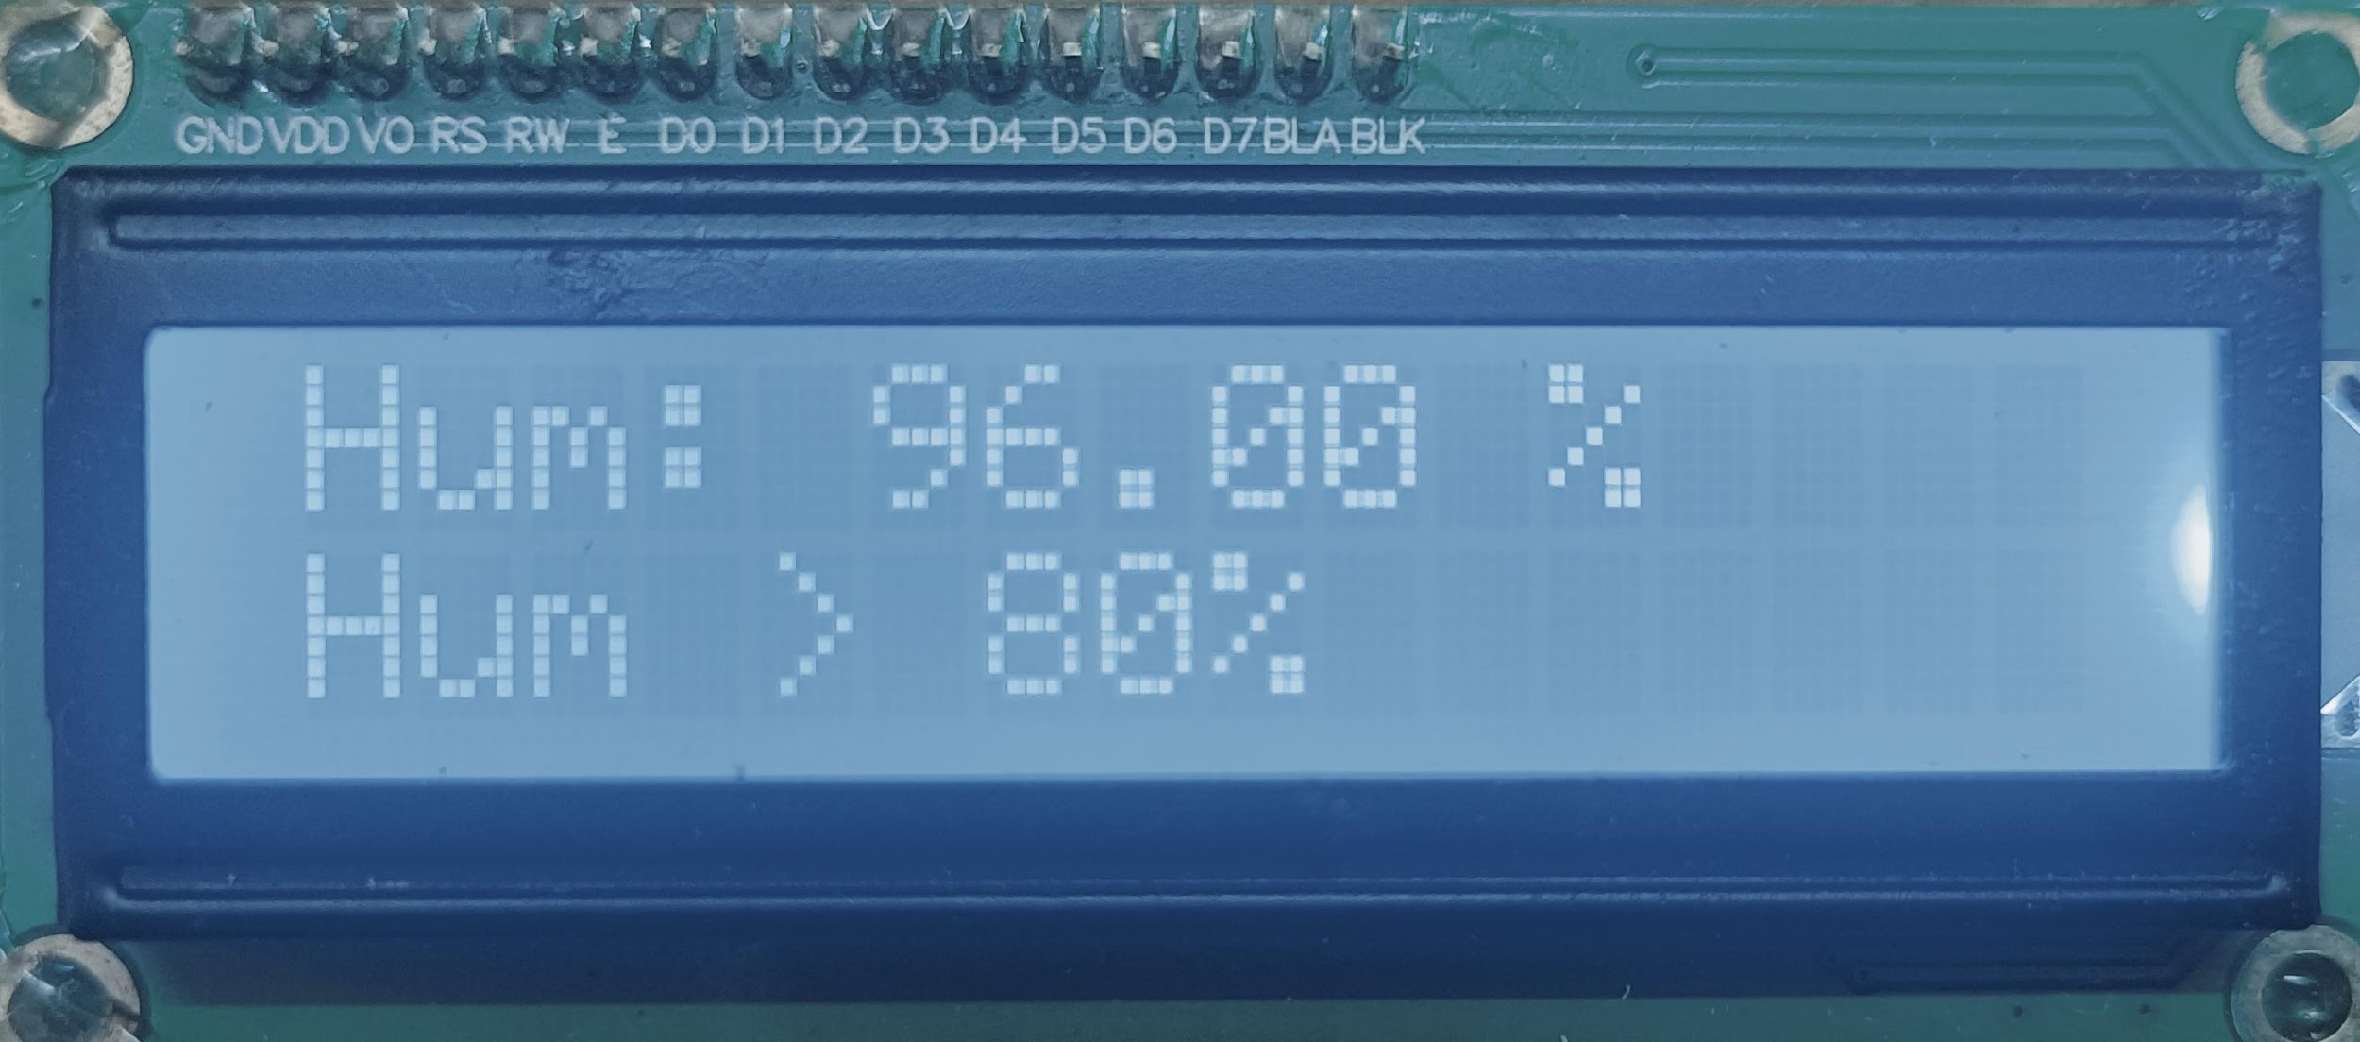
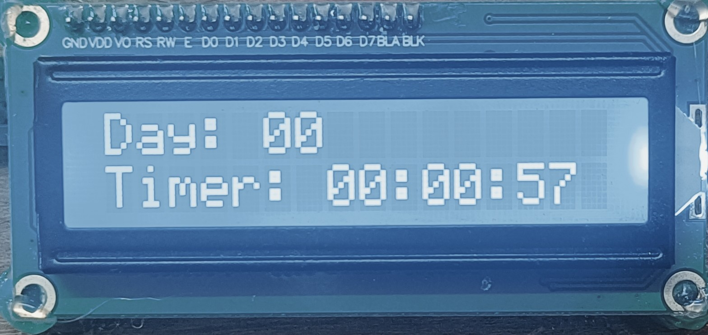
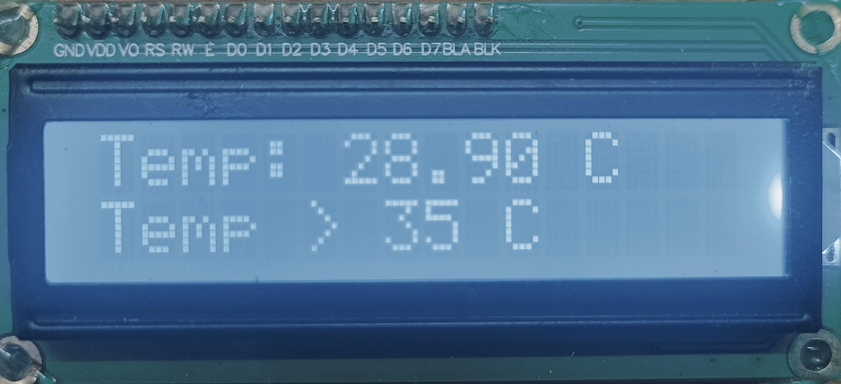
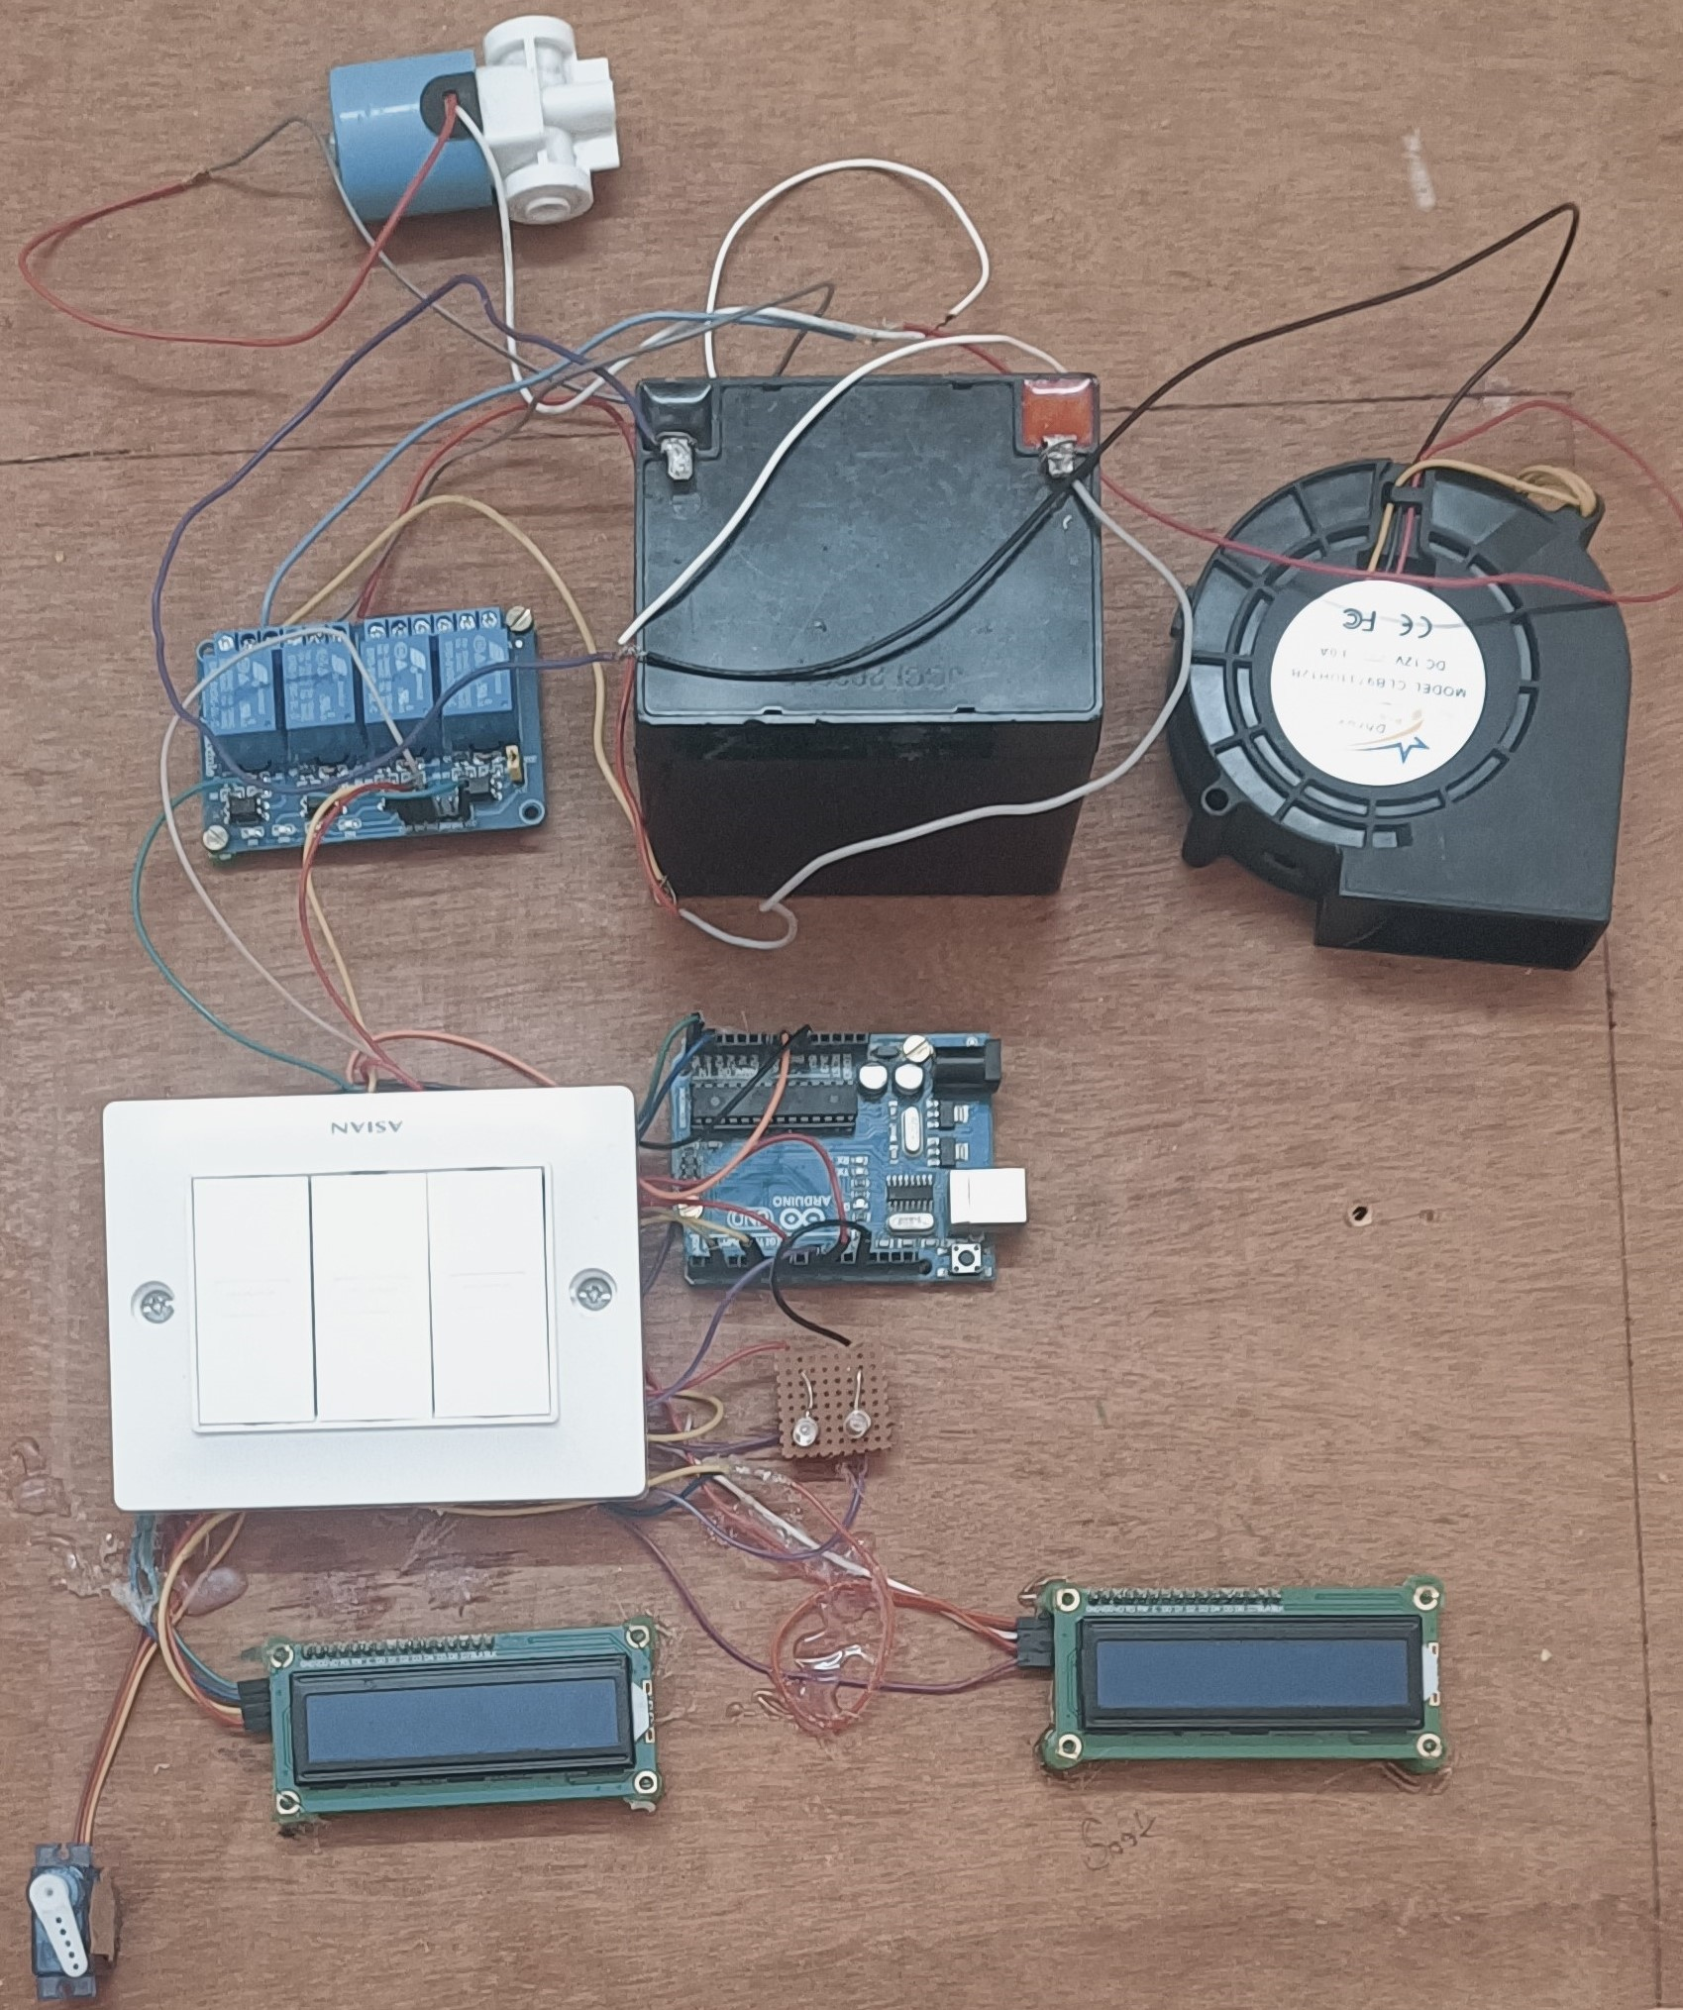
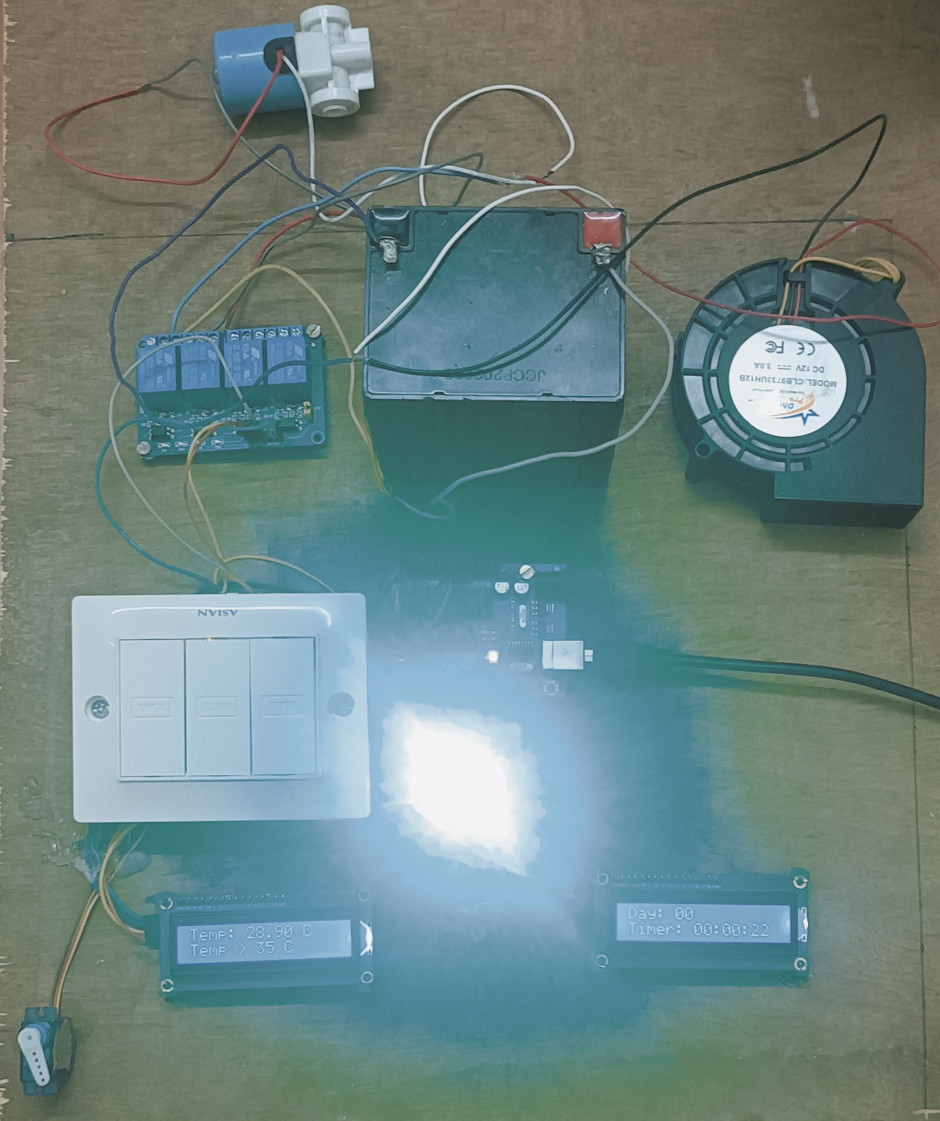
DEMO PROTOTYPE OUTPUT AND PHOTOS
DAY COUNT
HUMIDITY
TEMPERATURE

Slide 16
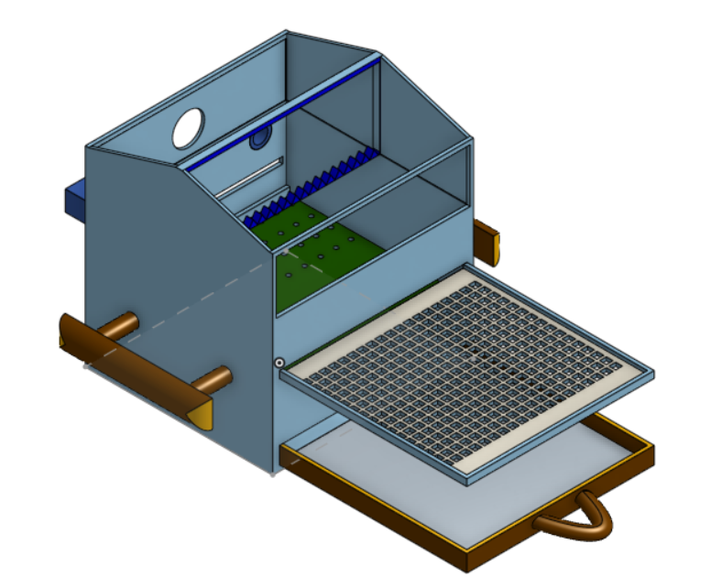
3D MODEL
Video Link:
https://drive.google.com/file/d/1blOVTax68mYB8AHz0drzgKCWX6eRfR6D/view?usp=sharing

Slide 17
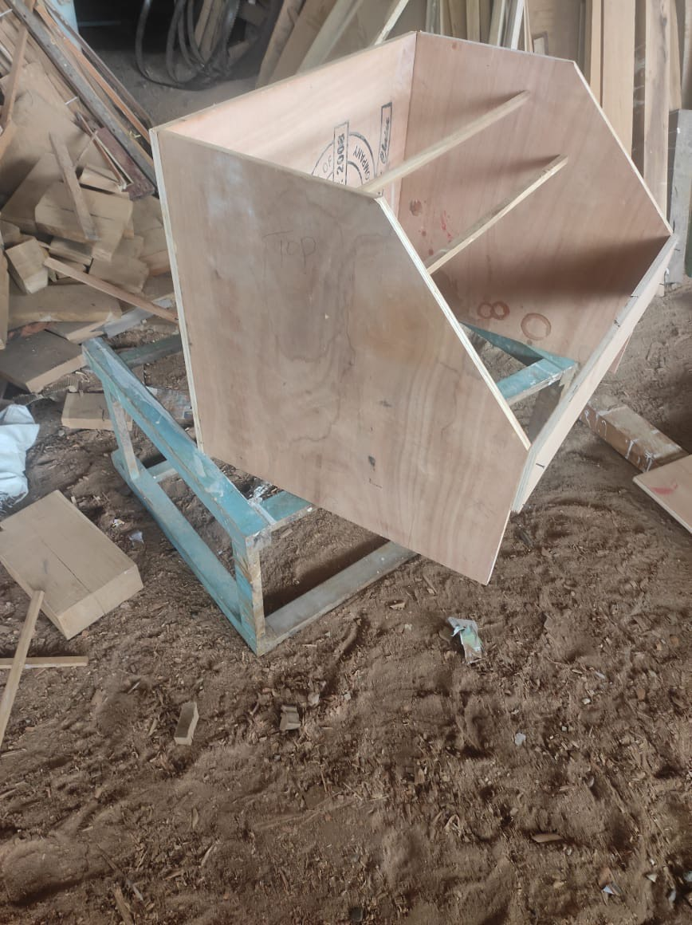
PROTOTYPE MODEL

Slide 18
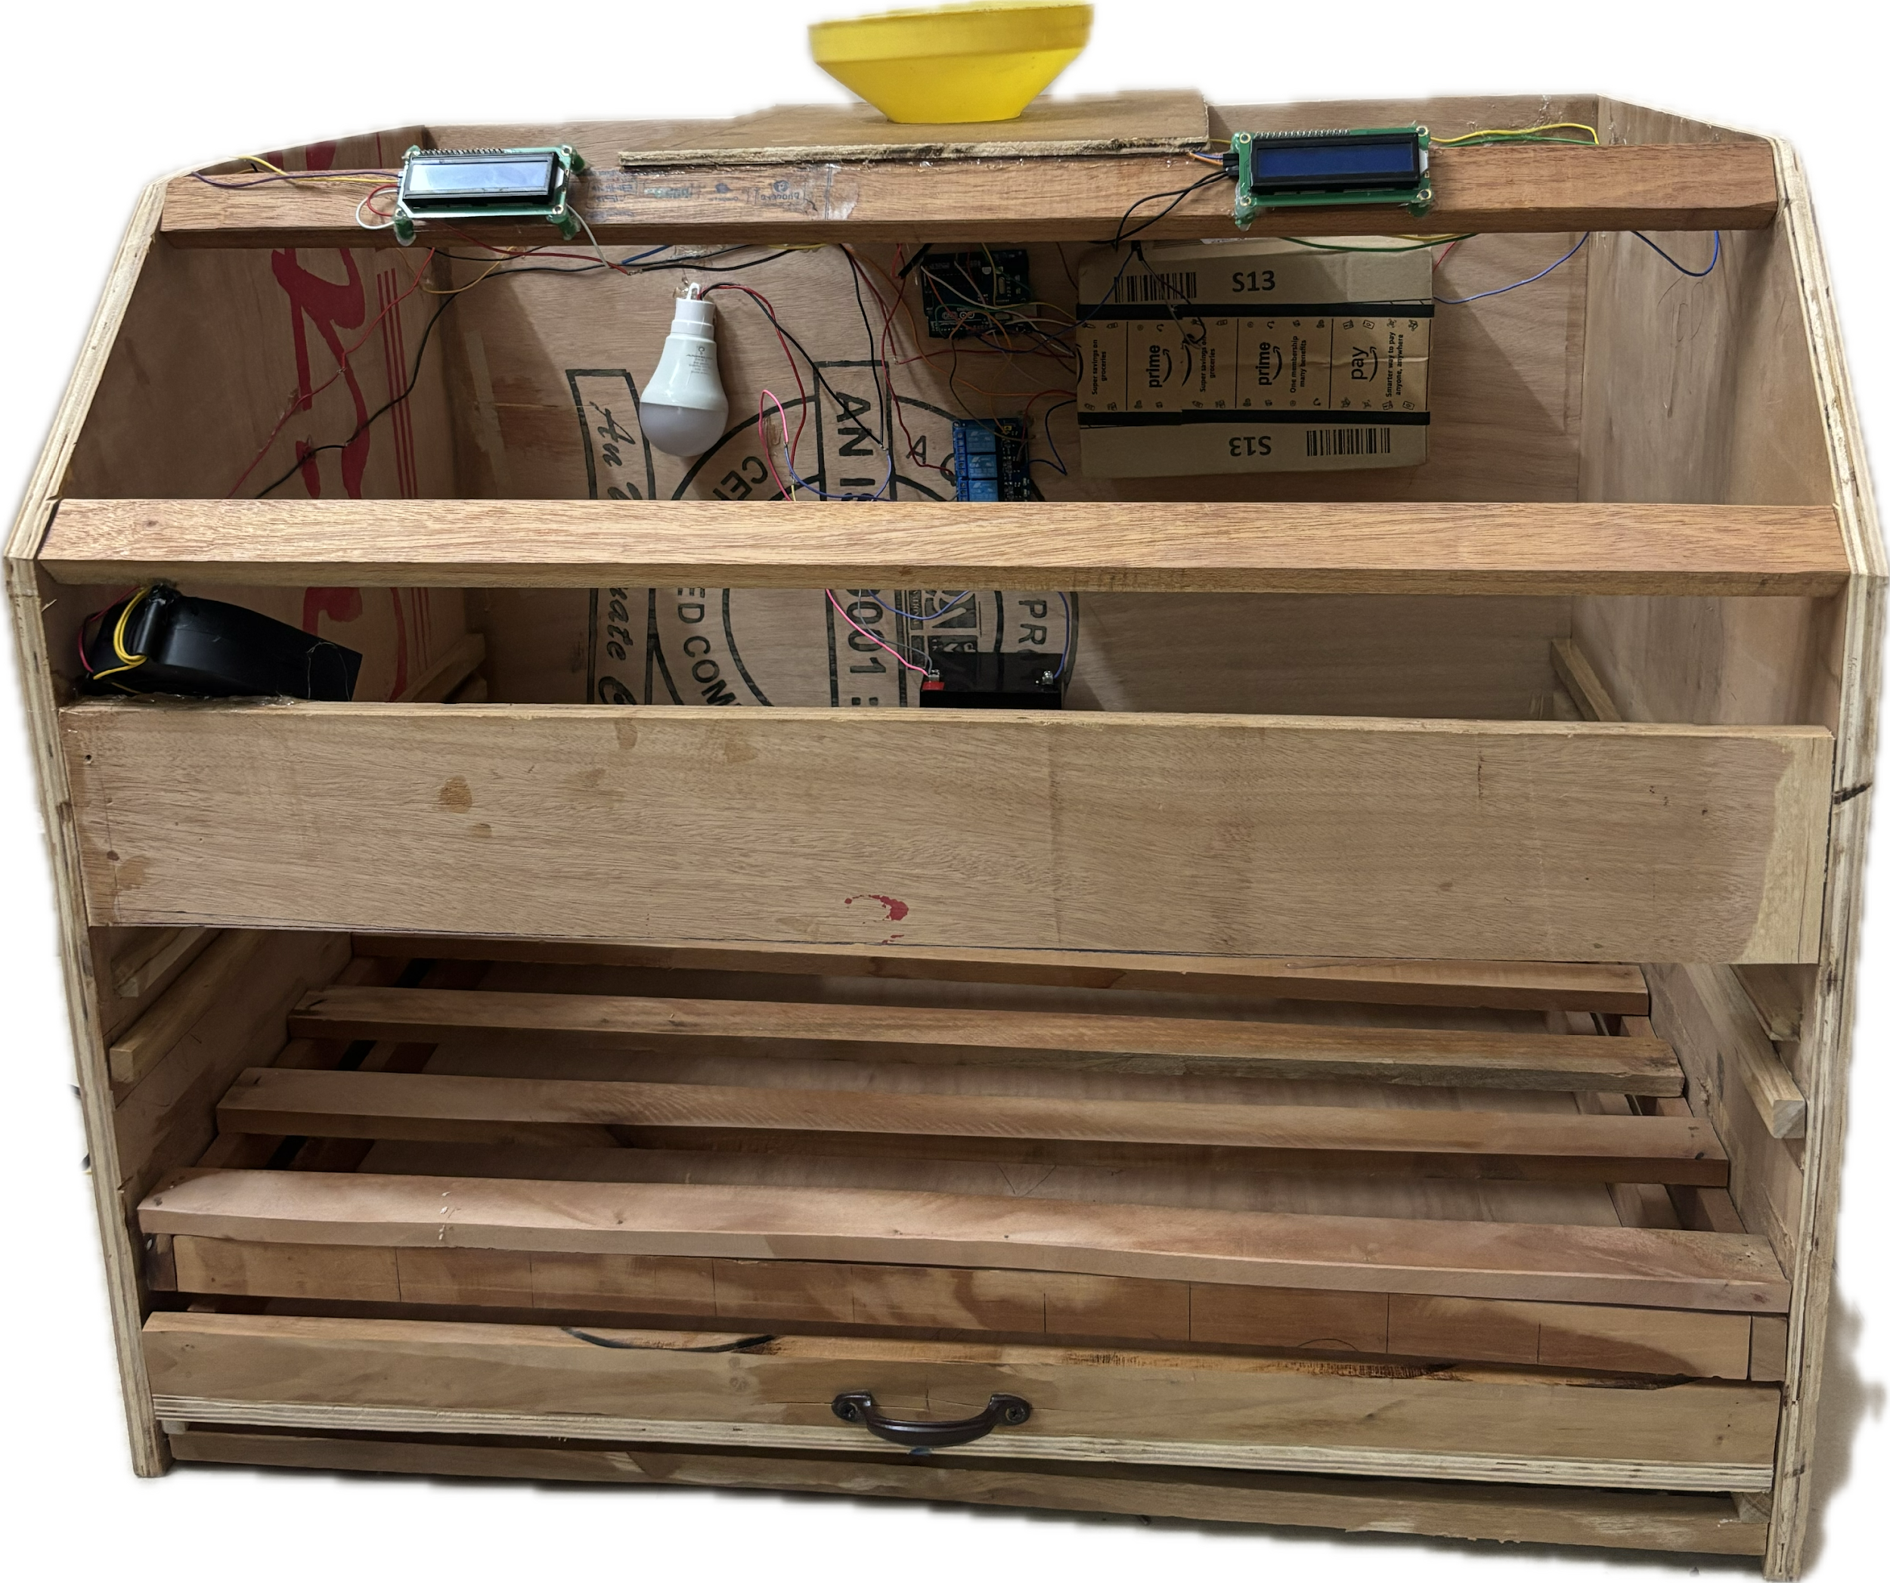
INTERFACING THE HARDWARE AND SOFTWARE TO THE PROTOTYPE MODEL

Slide 19
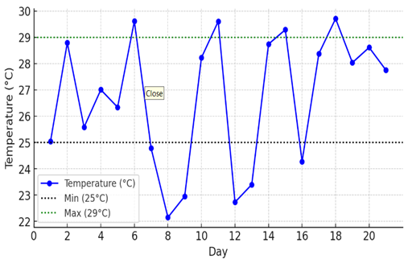
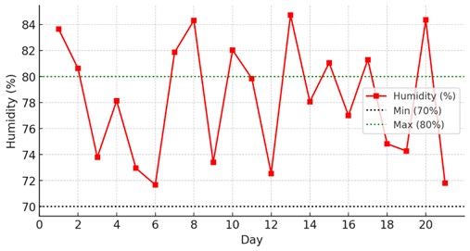
TEMPERATURE AND HUMIDITY PLOT
Graph showing values of temperature for 21 days
Graph showing values of humidity for 21 days

Slide 20
CONCLUSION
+
This project successfully developed an automated environmental control system using Arduino Uno to optimize temperature, humidity for silk farming. This system ensures a controlled environment, which is crucial for the health and productivity of silkworms, leading to better silk yields. The real-time monitoring via LCDs and visual indicators through LEDs provide an intuitive interface for farmers. This prototype demonstrates the potential for a cost-effective and scalable solution for silk farming, with precise control over the essential environmental factors.

Slide 21
FUTURE SCOPE
The development of real-time monitoring systems for silkworms, enabling early identification of diseases, isolation of affected worms, and effective maintenance, offers significant potential. Integration of these systems with a mobile app would facilitate smart farming, automated monitoring, providing real-time data to enhance the overall efficiency and sustainability of sericulture.

Slide 22
REFERENCES
A. Lee, G. Kim, S. -J. Hong, S. -W. Kim and G. Kim, "Classification of Dead Cocoons Using Convolutional Neural Networks and Machine Learning Methods," in IEEE Access, vol. 11, pp. 137317-137327, 2023, doi: 10.1109/ACCESS.2023.3338540.\
S. Nojiri, T. Nishimura, K. Tadakuma and T. Watanabe, "Flexible and Slim Device Switching Air Blowing and Suction by a Single Airflow Control," in IEEE Robotics and Automation Letters, vol. 8, no. 5, pp. 2637-2644, May 2023, doi: 10.1109/LRA.2023.3254465.
Sunardi, A. Yudhana and Furizal, "Tsukamoto Fuzzy Inference System on Internet of Things-Based for Room Temperature and Humidity Control," in IEEE Access, vol. 11, pp. 6209-6227, 2023, doi: 10.1109/ACCESS.2023.3236183.
Raju, C.G., Sarkar, S., Canamedi, V., Parameshwaranaik, J., Sarkar, S. (2024). A Review of Silk Farming Automation Using Artificial Intelligence, Machine Learning, and Cloud-Based Solutions.Jyothi, S., Mamatha, D.M., Raju, P.J., Sultana, S., Seetharamulu, J. (2021).
A Study on the Sericulture Farm Automation System Using the Internet of Things (IoT). In: Jyothi, S., Mamatha, D.M., Zhang, YD., Raju, K.S. (eds) Proceedings of the 2nd International Conference on Computational and Bio Engineering.
Z. Dong, X. Li, Z. Li and Y. Hou, "Modeling Simulation and Temperature Control on Thermal Characteristics of Airborne Liquid Cooling System," in IEEE Access, vol. 8, pp. 113112-113120, 2020, doi: 10.1109/ACCESS.2020.2997676.

Slide 23
THANK YOU

